Slide 1
Fighting in the Rearguard: U.S. Anti-LGBTQ+ Organizations’ Foreign Funding after Marriage Equality
Kristopher Velasco, Princeton University
Sebastián Rojas Cabal, Princeton University
American Sociological Association
August 6, 2022
Notes:
Introduction:
Good afternoon everyone, I’m [whoever will be going first] and along with my collaborator, [other person who isn’t standing up], we are going to presenting an investigation into foreign spending by anti-LGBTQ+ organization in the U.S.

Slide 2
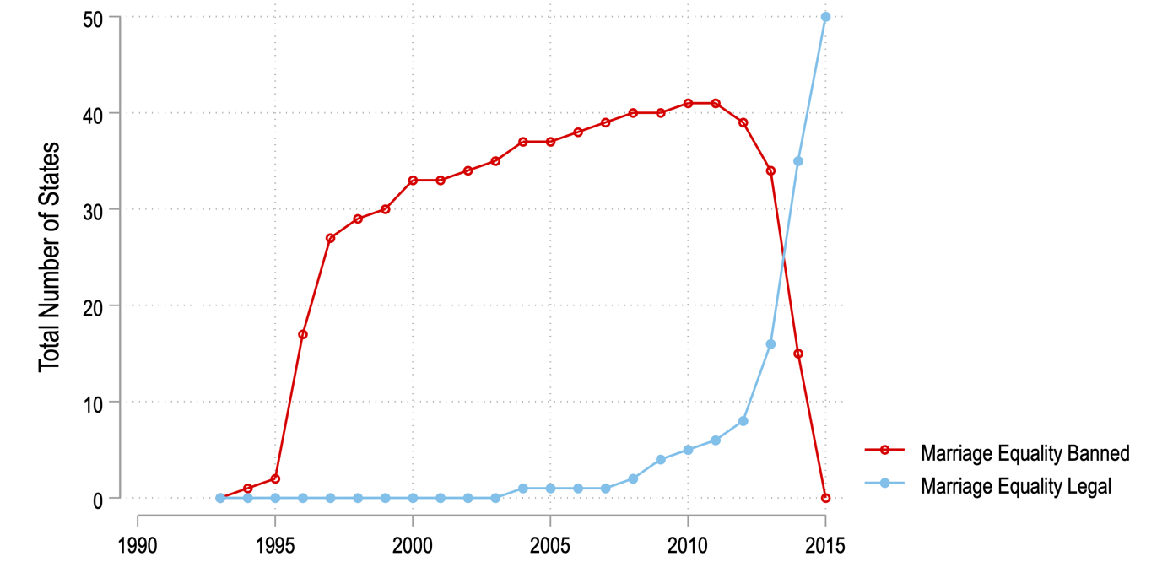
Introduction
(Staples 2019)
Notes:
We’d like to begin by providing a brief bit of context to our study.
This redline highlights the number of states that banned marriage equality between same-sex and different-sex couples in the U.S.
Blue line traces states that legalized marriage equality.
After Massachusetts became the first state to legalize marriage equality in 2004, we see a gradual and then exponential expansion in the number of states legalizing marriage equality.
This process culminated in the 2015 U.S. Supreme Court case that legalized same-sex marriage nationally.
In the years since legalization, several scholars investigate the impact this is having on the lives of same-sex couples within the U.S.: who gets married, how does it influence the health of their relationship, and other types of outcomes.
In our study, we expand on this work by turning our attention to the international space.
Do these policy adoptions have any global ramifications?

Slide 3
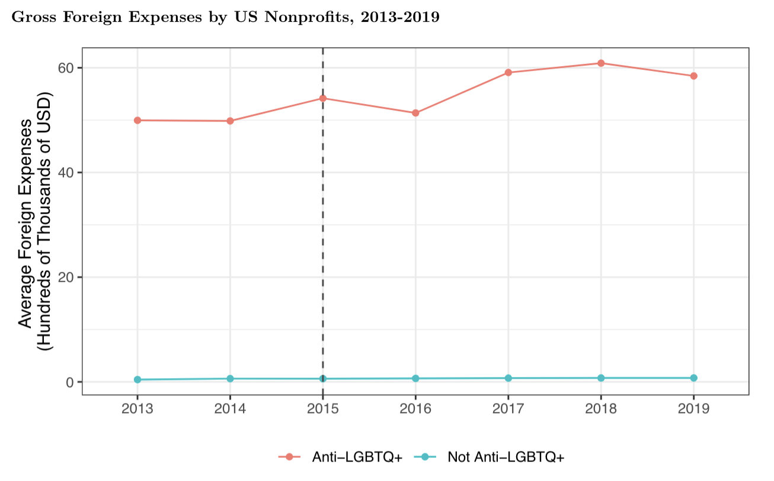
Introduction
Foreign Spending by U.S. anti-LGBTQ+ Organizations
~6% increase
~$5 million more/year
Notes:
Rather than burying the lede and waiting for the end to address this question, we are going to foreshadow our results now
To answer the question, yes.
Following marriage equality, anti-LGBTQ+ organizations opposed headquartered in those states started to re-direct more money internationally.
Specifically, there is an average 6% increase in total spending across these organizations, corresponding to roughly $5 million more dollars per year
And, as this figure shows, anti-LGBTQ+ organizations already spent significantly more money abroad than all other nonprofits (in the blue line).
Consequently, this funding helps contribute to the wave of anti-LGBTQ+ backlash currently taking place around the world.

Slide 4
Overview
Today’s talk:
Putting these results in Context
Why do these results matter?
How did we get to these results?
So, what are the implications for these results for cross-national sociology?
Notes:
Now that you know where we are going, the rest of today’s talk is dedicated to providing relevant context to interpret and understand the substantive importance of these findings.
Specifically, we are going to address these three questions:
Why do these results matter?
How did we get to these results?
And what are the implications of these results for cross-national sociology beyond LGBTQ+ politics?

Slide 5
Why
Notes:
So why should we care if anti-LGBTQ+ organizations are spending more money abroad?
First, increasing evidence of global backlash against LGBTQ+ communities around the world
This is part of growing illiberal transnational advocacy networks undermining LGBTQ rights, women’s rights, democracy, and other liberal norms established within the international arena.

Slide 6
“They have lost support in [the u.S.]. Now they are looking for countries where they can dump their ideologies. They do it where they feel they have more power.”
Why
(Staples 2019)
Notes:
Now, scholars and activists point to U.S. organizations of the financiers of this backlash
Frank Mugisha, an LGBTQ activist in Uganda, stated the following: [read quote]

Slide 7
“Sensing the battle against LGBT+ equality is being lost in the west, well-funded evangelical groups from America have been spending vast amounts of money…against LGBT+ equality in developing countries.”
Why
(Staples 2019)
Notes:
As one scholar stated: [read quote]
So clearly, there is this pervasive idea that U.S. organizations, particularly evangelicals, are shifting their money from the U.S. to foreign country.
And progressive policy change, like marriage equality, serves as the trigger.
From a social movements perspective, this is understandable. If political opportunities, or the ability to advance one’s mission, is closed off, you may turn internationally where you may have more success.
Afterall, U.S. organizations often have outsized sources of funding compared to advocacy groups abroad.

Slide 8
Evidence
Why
Notes:
So, there exists this dominant idea that following successes in the U.S, anti-LGBTQ+ organizations are redirecting tons of money elsewhere because they think they have better odds of advancing their agenda abroad.
Given that this idea is so dominant, where’s the evidence? What are people drawing on to make such claims?
Well, the evidentiary basis is actually quite thing.

Slide 9
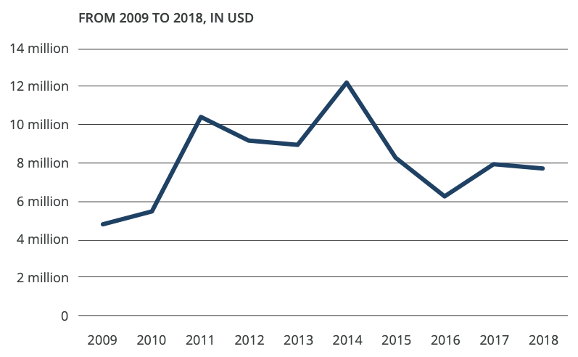
Evidence
Why
N = 10 organizations
(European Parliamentary Forum 2020)
Notes:
This graph is from the European Parliamentary Forum on Gender & Sexuality. They did this report wanting to study the global financing of anti-LGBTQ and anti-gender networks.
In this graph, we can see that from 2009 to 2014 foreign expenses were increasing, but this funding actually fell while marriage equality was expanding.
Granted, this report was only looking at 10 organizations.

Slide 10
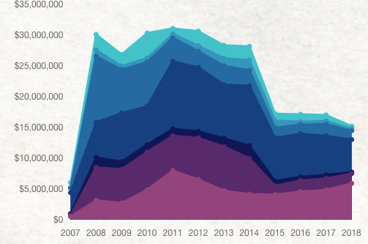
Evidence
Why
N = 28 organizations
(OpenDemocracy 2020)
Notes:
A larger report in 2020 was published by openDemocracy
Here, they looked at international spending by 28 organizations.
Still, though, there’s this same pattern that foreign funding decreased as marriage equality was expanding.
In some ways, this reversal makes sense.
Anti-LGBTQ+ groups could have felt demoralized and quit giving money, so there was less to spend.
Or, because of these losses, these groups decided to bring money back home to the U.S.
This seems plausible considering that right after marriage equality, we saw new anti-trans and religious liberty bills being proposed. So the fight did not all of a sudden stop in the U.S.

Slide 11
“Sensing the battle against LGBT+ equality is being lost in the west, well-funded evangelical groups from America have been spending vast amounts of money…against LGBT+ equality in developing countries.”
Why
(Staples 2019)
Notes:
Despite the current longitudinal data on foreign spending by at least some U.S. organizations, this sentiment persists.
While it could be that their subjective assessments are just wrong, we opned up today’s talk by demonstrating that this is true.
So, how is it that we got to these different conclusions?

Slide 12
How
Data: IRS Form 990
Nonprofit Tax Forms
Electronically released by the IRS in 2016
Allows collection of financial + administrative data on 100,000’s of nonprofits
Sample:
U.S. nonprofit organizations with at least $200,000 in gross receipts
~325,000 nonprofits total
2013-2020
Note: Churches are not required to disclose finances to the federal government

Slide 13
Measures
How
Dependent Variable:
Volume: Total dollars spent internationally (logged)
Priority: Proportion of foreign expenditures out of total expenses
International Focus: Indicator for whether the organization spends money internationally or not
Independent Variables:
Anti-LGBTQ+ indicator
State-level marriage equality
Anti-LGBTQ+ x Marriage Equality Legalization

Slide 14
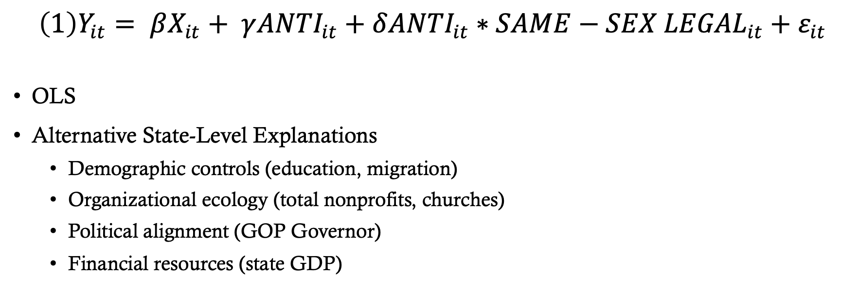
Methods
How
$\left(1\right)Y_{it}= βX_{it}+ γ{ANTI}_{it}+δ{ANTI}_{it}∗{SAME−SEX LEGAL}_{it}+ε_{it}$
OLS
Alternative State-Level Explanations
Demographic controls (education, migration)
Organizational ecology (total nonprofits, churches)
Political alignment (GOP Governor)
Financial resources (state GDP)

Slide 15
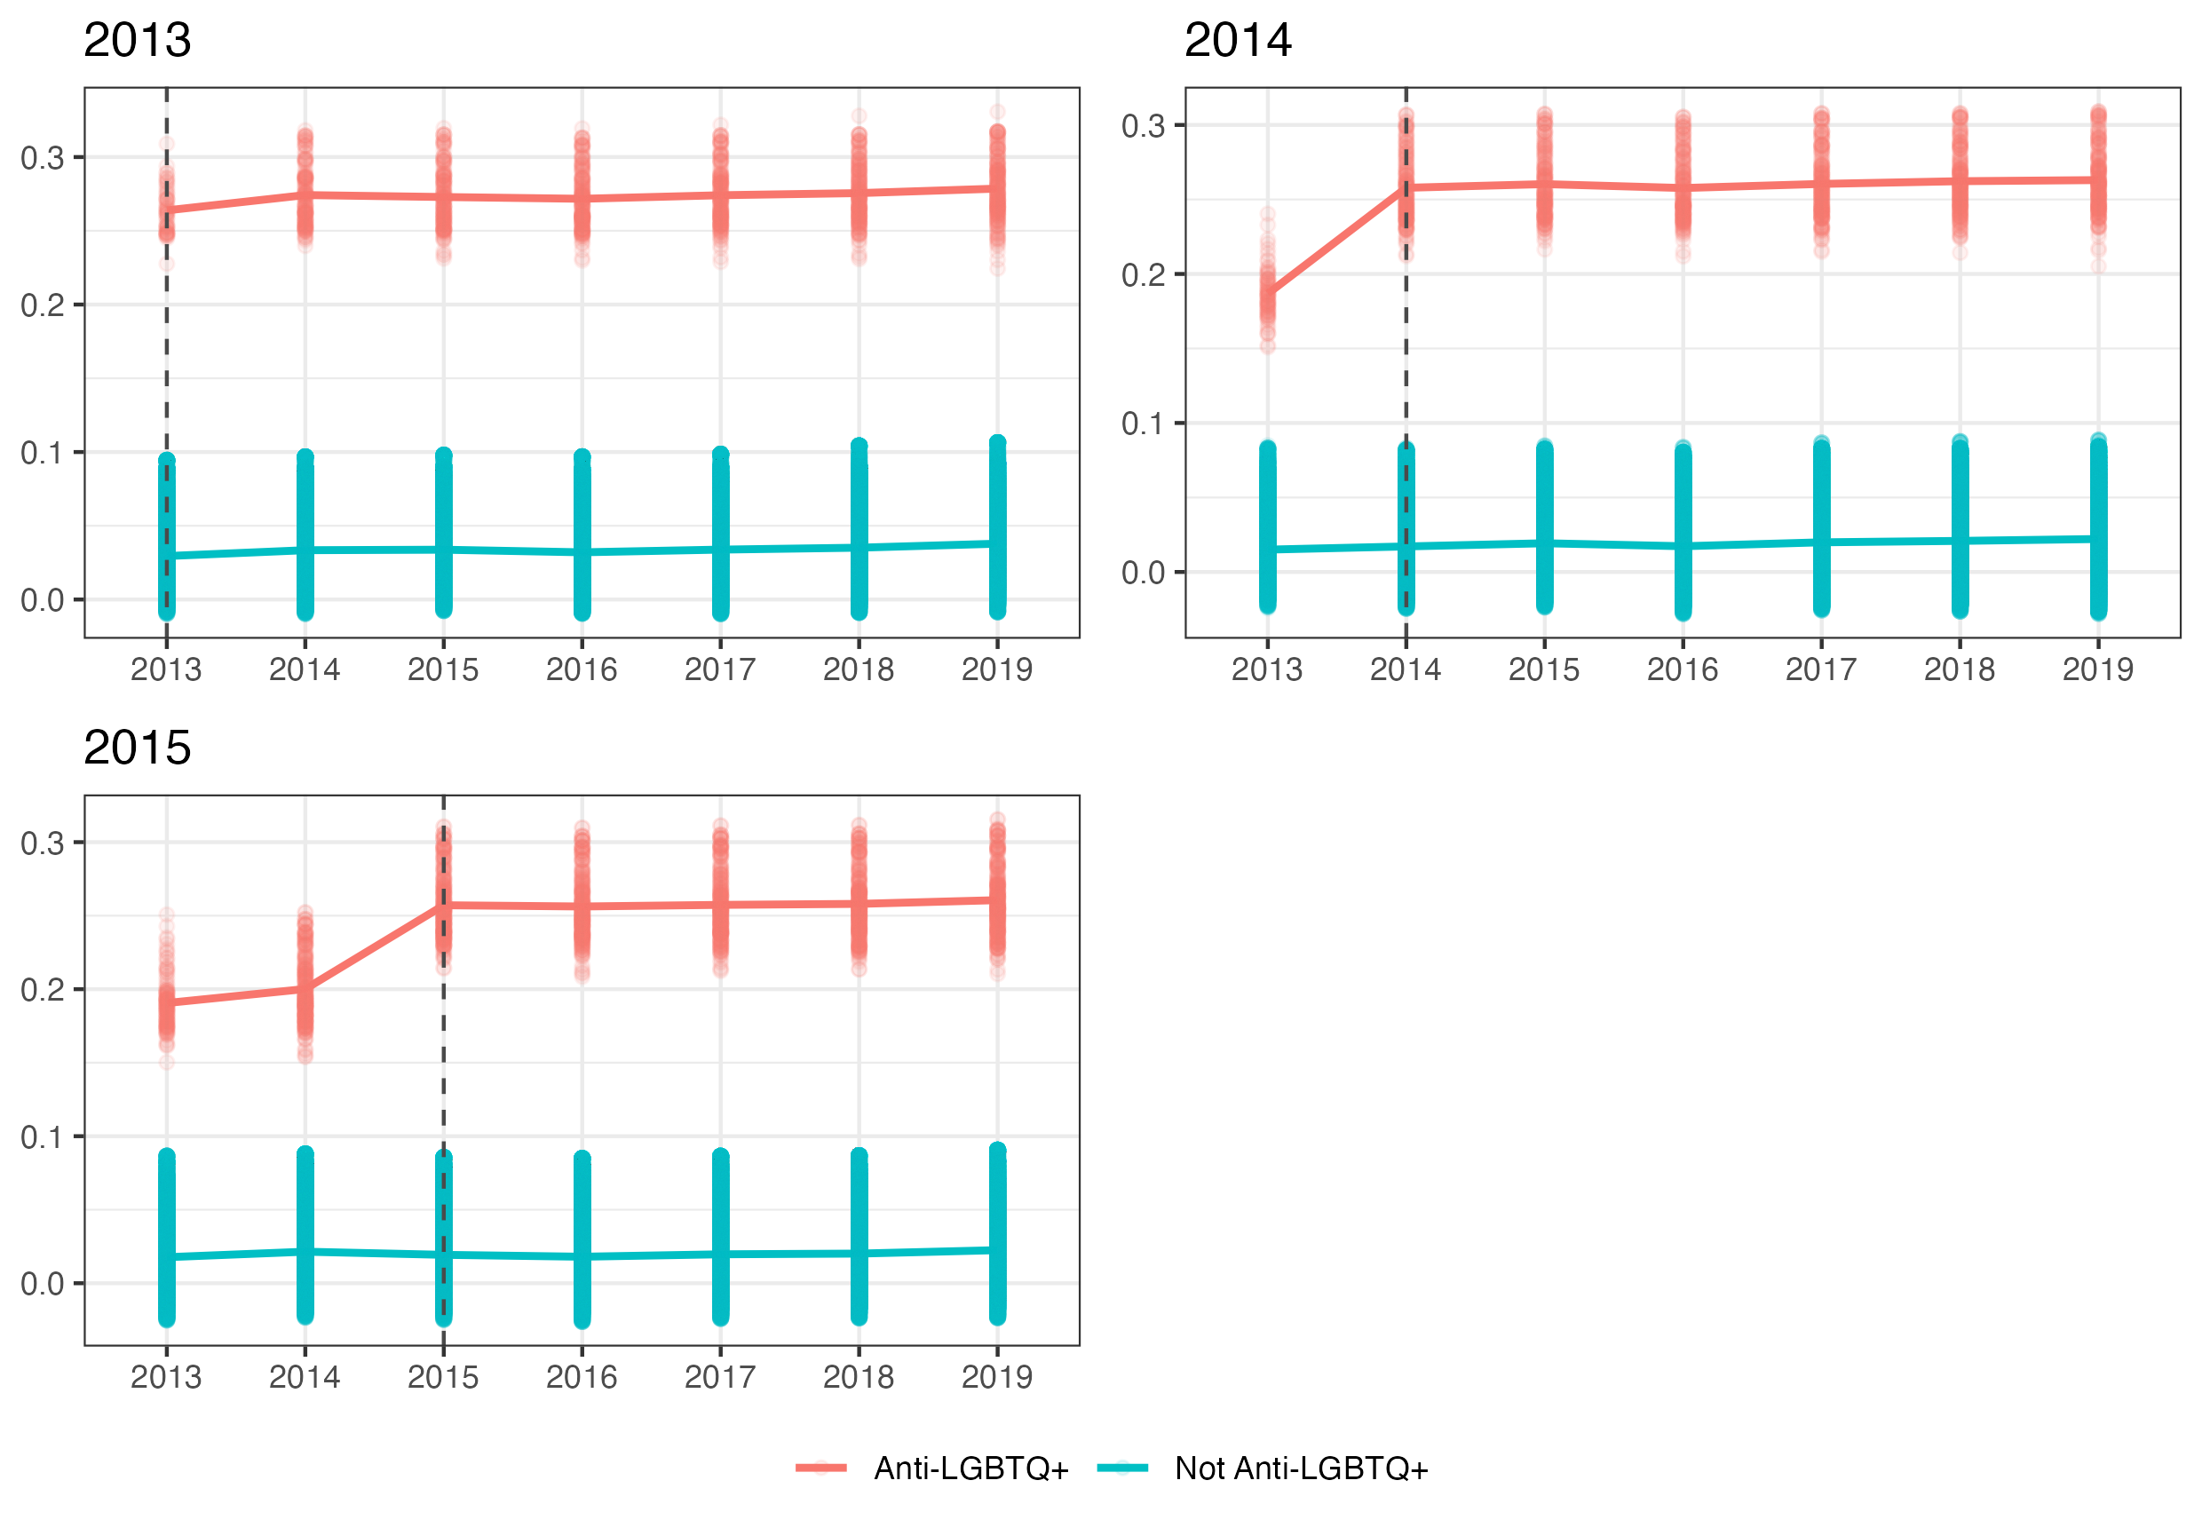
How
Predicted Values of Budget priority
Proportion of Foreign Expenses
of Total Expenses

Slide 16
How
Predicted Values of xx

Slide 17
Implications
So, what
Financing of Transnational Networks
Rise of Illiberal & Right-Wing networks
Realizing fight is not over in the U.S., will money come back?
Notes:
Lots of research highlights that the U.S. serves as the financiers of transnational networks, however, there’s less research on why the U.S. plays this role. What are the triggers that influence the scale and timing of foreign investment by these organizations? We contribute toward this line of research by linking domestic policy changes directly influence how money moves through these networks – which then ultimately influences outcomes around the world.
Much attention now to the rise of illiberal and right-wing networks. There’s research showing how these are curtailing rights for women, LGBTQ+ communities, racialized minorities, and democratic norms. But where are these groups growing in influence right now? Welll, perceptions changed during the presidency of Barack Obama and caused some organizations to turn their gaze outward. And because money from the U.S. can be so substantial, especially compared to developing countries, this results in the high profile backlashes we see around the world.
But one important question looking over our research is the fact that anti-LGBTQ+ organizers haven’t given up on the U.S. Clarence Thomas said he wants to re-evaluate same-sex marriage. So how can this be? One answer is that these groups simply have so much money they can do both. Second, with more years of data, we will eventually be able to see if this trend reverses. The election of Donald Trump may have shifted perceptions again that these policy aims are still achievable.

Slide 18
Next steps
Next steps
Collect additional data back to 2008
Use text analysis to classify “anti-LGBTQ+” nonprofits based on mission statements
Switch to causal framework by using synthetic controls and difference-in-differences
Notes:
Finally, some next steps in this project’s development.
We are scanning PDFs en masse to get data going back to 2008
Incorproate alternative ways to classify anti-LGBTQ+ organizations using text analysis
Once more years of data are collected, we’ll be able to switch toward more causal frameworks and test whether these significant associations hold under more stringent assumptions.

Slide 19
Questions?

